Slide 1
Computer Programming ICT-1205
Dr. Mohammad Abu Yousuf
yousuf@juniv.edu

Slide 2
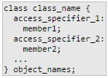
Class
Classes are an expanded concept of data structures: like data structures, they can contain data members, but they can also contain functions as members.
An object is an instantiation of a class. In terms of variables, a class would be the type, and an object would be the variable.
Where class_name is a valid identifier for the class, object_names is an optional list of names for objects of this class. The body of the declaration can contain members, which can either be data or function declarations, and optionally access specifiers.

Slide 3
Class
Access specifier :
An access specifier is one of the following three keywords: private, public or protected. These specifiers modify the access rights for the members that follow them:
private members of a class are accessible only from within other members of the same class (or from their "friends").
protected members are accessible from other members of the same class (or from their "friends"), but also from members of their derived classes.
public members are accessible from anywhere where the object is visible.

Slide 4
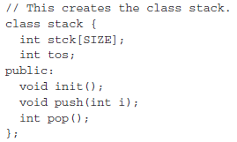
Class
By default, all members of a class declared with the class keyword have private access for all its members. Therefore, any member that is declared before any other access specifier has private access automatically. For example:
creates an object called mystack of type stack:
stack mystack;

Slide 5
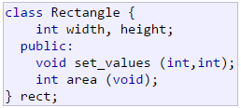
Example of Class
Declare a class (i.e., a type) called Rectangle and an object (i.e., a variable) of this class, called rect.
This class contains four members: two data members of type int (member width and member height) with private access(because private is the default access level) and two member functions with public access: the functions set_values and area.

Slide 6

Example of Class
After the declarations of Rectangle and rect, any of the public members of object rect can be accessed as if they were normal functions or normal variables, by simply inserting a dot (.) between object name and member name. This follows the same syntax as accessing the members of plain data structures. For example:
The only members of rect that cannot be accessed from outside the class are width and height, since they have private access and they can only be referred to from within other members of that same class.

Slide 7
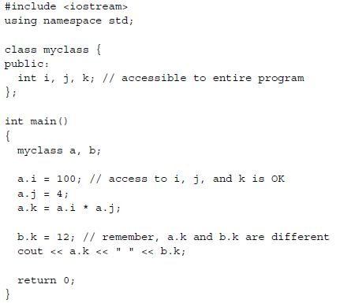
Example: Class

Slide 8
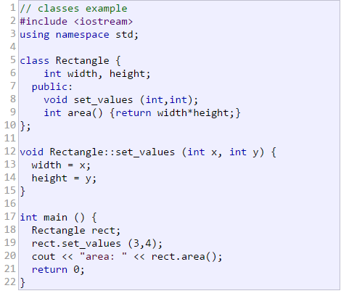
Output:
area: 12

Slide 9
Explanation of previous program:
Notice the use of the specifier Recangle:: as a prefix to each function name. This is necessary for each member function definition that is given outside of its class definition.
The scope resolution operator :: is used to tie the function definition to the Rectangle class. Without this specifier, the compiler would not know that the function being defined is a member function of the Rectangle class.

Slide 10
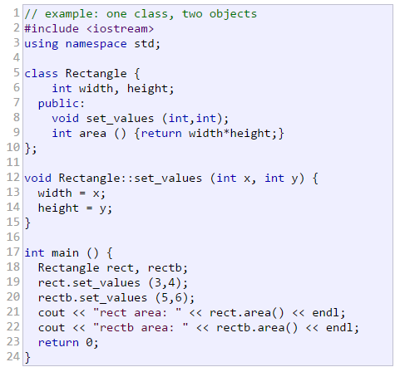

Example : 2

Slide 11
Constructors
A constructor is a member function which is automatically called whenever a new object of this class is created, allowing the class to initialize member variables or allocate storage.
A constructor function must have the same name as the class itself, and it is declared without return type not even void.

Slide 12
Parameterized Constructors
It is possible to pass arguments to constructor functions. Typically, these arguments help initialize an object when it is created. To create a parameterized constructor, simply add parameters to it the way you would to any other function.

Slide 13
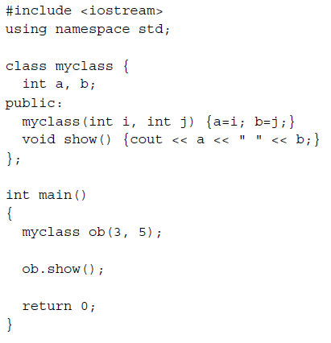
Parameterized Constructors

Slide 14
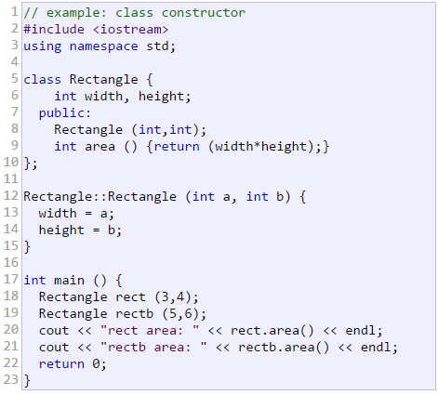

Parameterized Constructors

Slide 15

The results of this example are identical to those of the previous example. But now, class Rectangle has no member function set_values, and has instead a constructor that performs a similar action: it initializes the values of width andheight with the arguments passed to it.
Notice how these arguments are passed to the constructor at the moment at which the objects of this class are created:
Constructors cannot be called explicitly as if they were regular member functions. They are only executed once, when a new object of that class is created.

Slide 16
Overloading constructors
Like any other function, a constructor can also be overloaded with different versions taking different parameters: with a different number of parameters and/or parameters of different types. The compiler will automatically call the one whose parameters match the arguments:

Slide 17
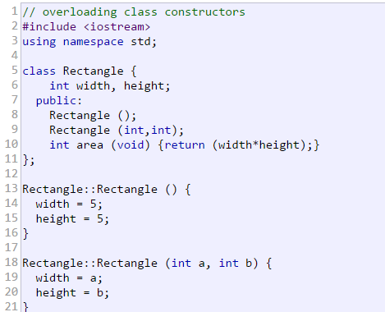

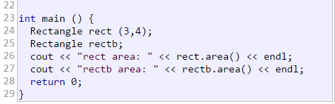
Example: constructor overloading

Slide 18
Explanation of previous example:
In the above example, two objects of class Rectangle are constructed: rect and rectb. rect is constructed with two arguments, like in the example before.
But this example also introduces a special kind constructor: the default constructor. The default constructor is the constructor that takes no parameters, and it is special because it is called when an object is declared but is not initialized with any arguments. In the example above, the default constructor is called for rectb. Note how rectb is not even constructed with an empty set of parentheses - in fact, empty parentheses cannot be used to call the default constructor

Slide 19
Thank you

